Slide 1
PERTEMUAN 10 LnT MOBILE APPLICATION DEVELOPMENT
Christopher Vinantius

Slide 2
Materi Pertemuan 10
Intent
Menu
Dialog
SharedPreferences

Slide 3
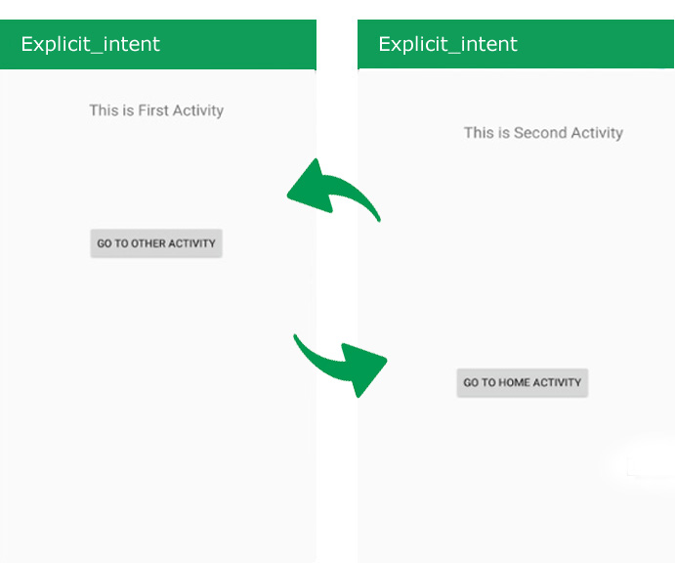
Explicit Intent

Slide 4
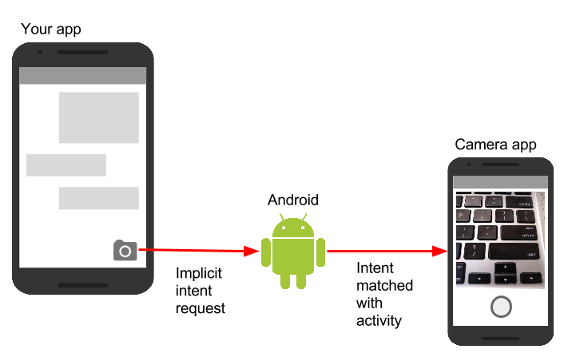
Implicit Intent

Slide 5
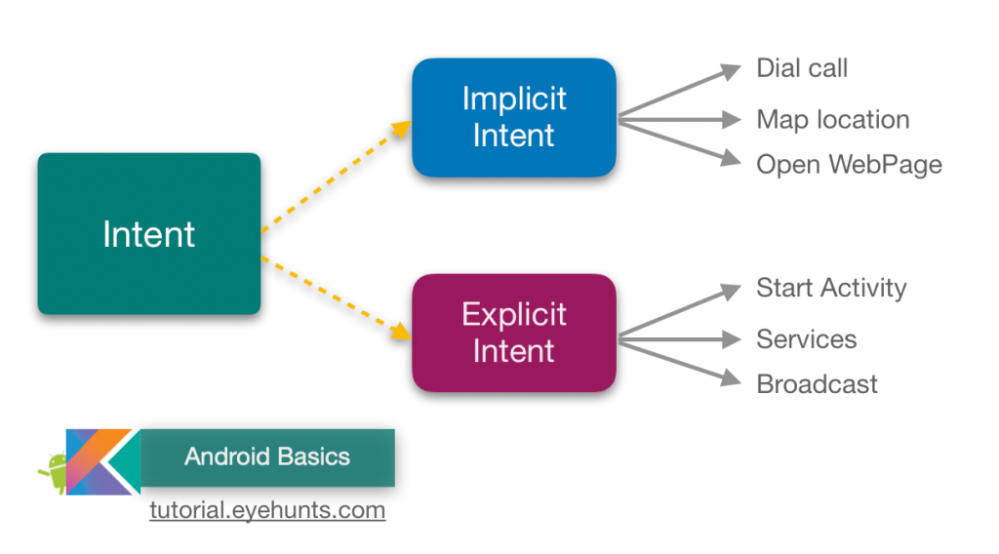
Implicit Intent vs. Explicit Intent

Slide 6
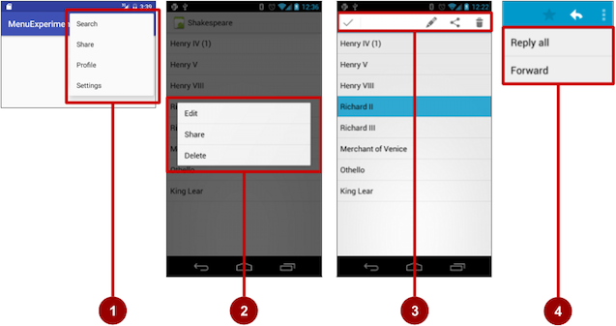
Menu

Slide 7
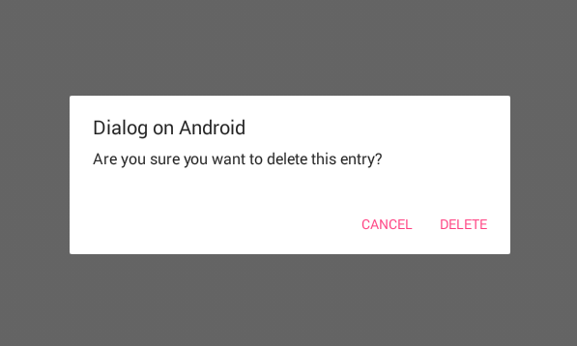
Alert Dialog

Slide 8
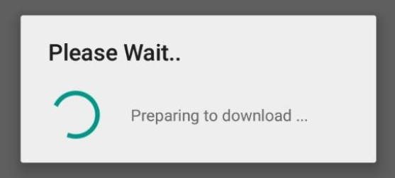
Progress Dialog

Slide 9
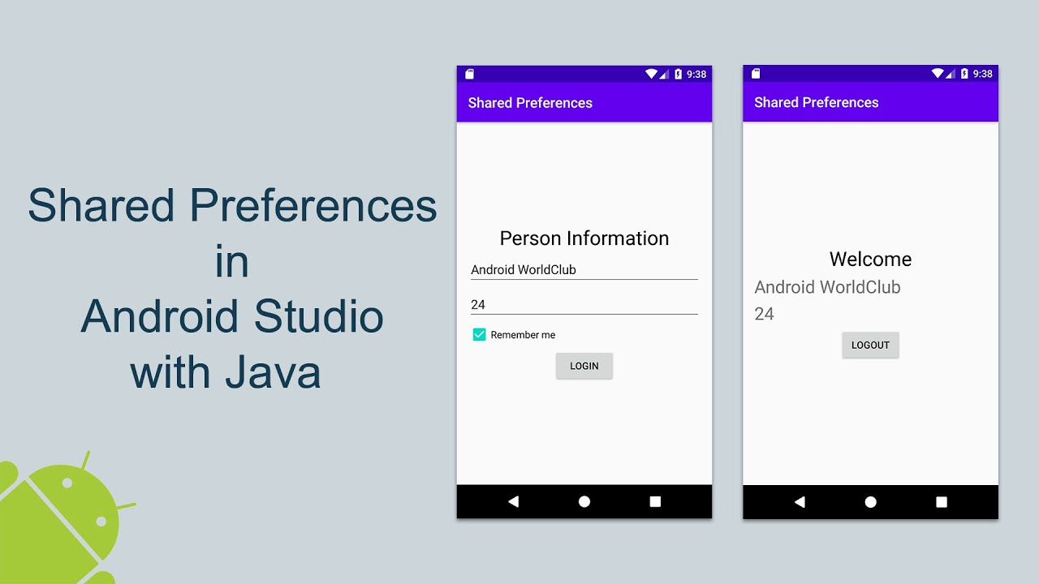
SharedPreferences

Slide 10
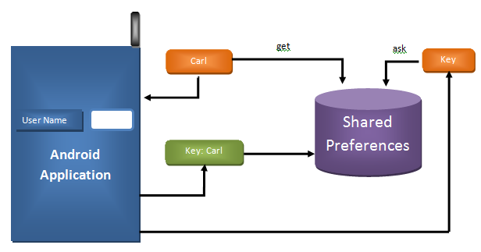
Cara Kerja SharedPreferences

Slide 11
Berbagai informasi tentang intent, menu, dialog, dan SharedPreferences dapat dieksplor lebih dalam melalui link-link berikut.
https://tutorial.eyehunts.com/android/types-implicit-intent-explicit-intent-android/
https://www.geeksforgeeks.org/what-is-intent-in-android/
https://developer.android.com/guide/topics/ui/menus?hl=id
https://developer.android.com/guide/topics/ui/dialogs?hl=id
https://developer.android.com/training/data-storage/shared-preferences?hl=id

